Slide 1
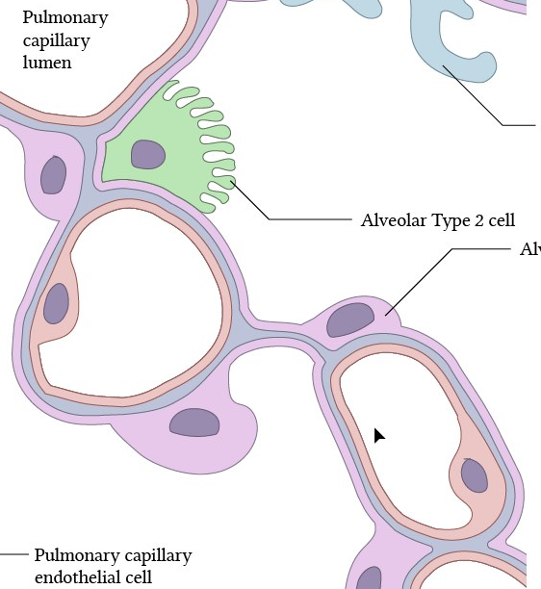
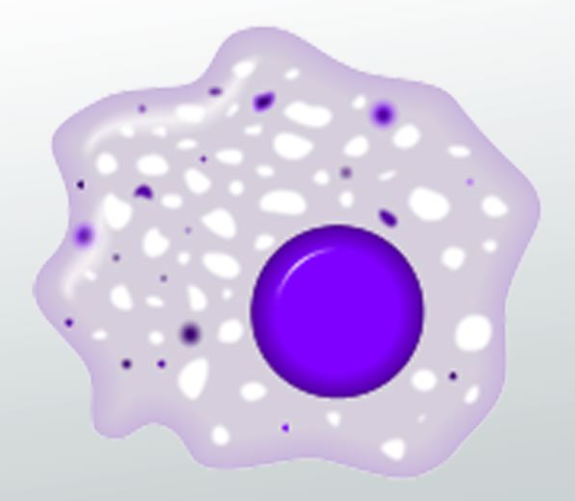
SP-D (SFTPD)
CD91 (LRP1)
SR-B1 (SCARB1)
ABCA1/ABCG1
GM-CSF (CSF2)
CSF2R
VEGFR2 (KDR)
VEGFA
TGFBR1/2
TGFB1
PDCD1
Alveolar epithelial cells (AECs)
CD274
Macrophages
MERTK
IL10
GAS6
IL10R

